Slide 1


Learning and Creativity by Digital Re-Combination
Benjamin Koo
Tsinghua University

Slide 2
Challenge
Can people learn new materials rapidly and create new solutions using modern digital solutions?

Slide 3
Results
People can learn new materials and create new and innovative solutions following the XLP game plan.
More than 25 experiments have been done for K-12, undergraduate, graduate, and teacher participants on a variety of topics (creating 3-D printers, softwarea development, Web databases). Most of XLP experiments were done in four days, and their demonstration results are available on videos in multiple countries (China, US).

Slide 4
New Learning Framework
Extreme Learning Process (XLP) is a new way of learning that creates new solutions in teams to compete after learning a variety of related knowledge using modern digital technology in a realistic learning environment.
Learning key knowledge needed for an enterprise solution including marketing, law, digital publishing, and domain knowledge.
Collaborative competition-based crowdsourced learning and creativity
It is Extreme Learning because it stretches the limit of human capability in learning as it asks participants to learn new materials rapidly and then construct new solutions within days.

Slide 5
“Extreme” Learning
ICAP is progressive learning framework from simple to sophisticated (Chi)
Passive (Receiving): Watching a lecture video or a demonstration
Active (Selecting): Do something that selectively manipulates the learning materials;
Constructive (Generating):Generate information beyond what was presented; ask questions
Interactive (Collaborating): Students collaborating with each other through dialog
After learning short lectures, participants go directly into interactive model and constructive new solutions in teams to compete with other teams. Furthermore, often, participants need to complete the entire process within four days rather then months or years of learning.

Slide 6
XLP is Competition-Based Learning
Crowdsourcing competition such as TopCoder and Hatckathone follows the game theory such as Min-Max principle (Wu, Tsai, Li 2013) where one party minimizes one objective function, the competing party maximizes the same function.
XLP uses a collaborative competition approach to maximize learning and creativity:
Challengers and workers: One group acts as challengers coming up new issues, and workers continuously respond to these challenges.
Simulating court and legal proceedings: During competitions, one party may challenge various issues such as IP issues via XLP court system to resolve any dispute among participants.

Slide 7
XLP is Extreme Crowd Learning
XLP encourage participants (lecturers, challengers, and workers) to seek expertise and knowledge via personal communication or the web during the entire process.
Lecturers: To seek new knowledge and application techniques. Depending on levels, lecturers can be world well known professors or experts (such as xxx of Hatckathone) or high-school teachers.
Challengers: To seek new directions to improve the current solutions. This can be student or faculty participants.
Workers: To see new solutions to meet the issues addressed by Challengers. Workers are mostly students who signed up XLP. As currently, XLP is an informal education without college certifications, the admission criteria for workers are just average students, but they must be committed to dedicate 4 days to an XLP event.

Slide 8
XLP is Self-Organizing learning

Slide 9
Lessig’s Forces
Market
Market (Exchange Mechanisms)
Transaction Process
Asset Exchange/Lease/Rental
(交易机制)
Crowd Decisions
Architecture
Law
Law (Conflict Resolution)
Evidence Preparation
Proof of Existence/Work
(科技支撑)
(诉讼机制)
Transporting Persons and Goods
Norm
(文化与传媒)
Norm (Culture and Media)
Media Publishing
Customer Reach
Code and other laws in cyberspaces, by Lawrence Lessig

Slide 10








Activities within the Framework
Market
(Exchange Mechanisms)
Crowd Decisions
Architecture
Law
Law (Conflict Resolution)
Evidence Preparation
Proof of Existence/Work
(Technology)
(Conflict Resolution)
Norm
(Culture and Media)

Slide 11
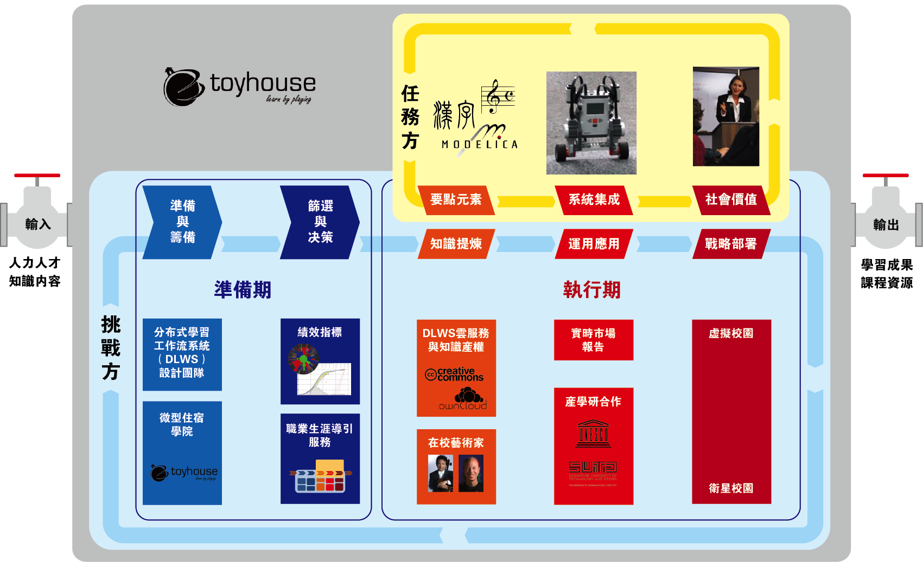
极限学习的过程架构
任务执行方
挑战设计方

Slide 12
成果发布流程
数字化
发布
产品开发
内容分布
产品展示
规划管理
网络发布平台
建模工具(编程语言, 仿真、渲染工具)
媒体发布会议
探索需求
内容分享工具 (Git)
雏形组装(Lego, Makeblock)
数据采集工具 (相机, 麦克风,
传感器)
计算资源
故事板(PowerPoint)
测试仪器
时间表 (SmartSheet)
集成工具(Gitbook)
635 方法
预算表 (SmartSheet)
项目使命
层次化任务协议 (XMind)

Slide 13





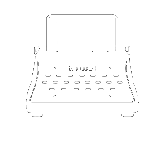





写作
排版
审稿
付印
数字化
发布
编码
界面
测试
包装
方案
建模
雏形
生产

Slide 14
单兵作战的宿命？
长期奋战，旷日耗时
探索
需求
内容
分布
产品
开发
规划
管理
数字化
发布

Slide 15
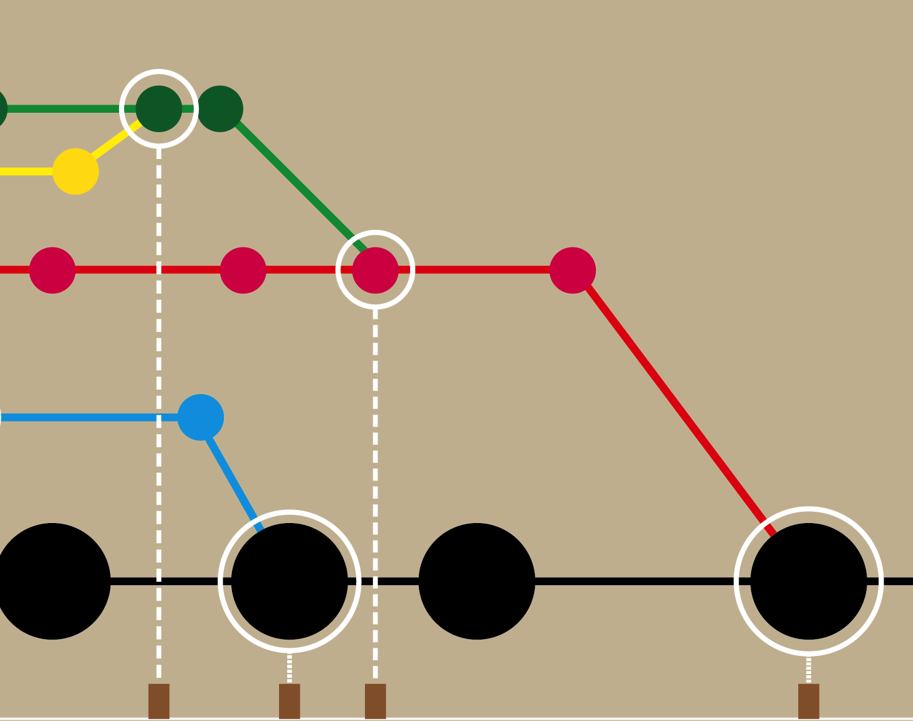

互联网资源的重组
探索
需求
内容
分布
产品
开发
规划管理
数字化
发布

Slide 16
XLP Case Studies
基于物联网技术的自动化供应链 (8月. 2012)
登陆并开发无人岛 (1月. 2013)
Sustainable Digital Publishing (August 2013)
Atomic Microscope (Jan. 2014)
US-China Green Electronic online competition (May 2014)
Digital Publishing Workflow (Sept. 2014)
Constitution of Hackathone (Oct. 2014)
Thacks Tsinghua University Hackathone (Nov. 2014)

Slide 17
探索团队合作的极限！

Slide 18
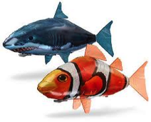



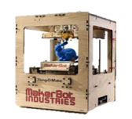
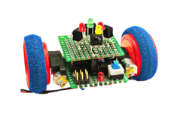

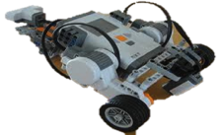
开发无人岛
Zeppelins
Camera
Computer
International Relations
Economical Forces
Law and Intellectual Properties
Island (3D printed)
System Modeling
and Simulation
Swarm Robot
Sea
Land

Slide 19
跨学科的参与人员
216+ Applicants（Up to 2012-12-26）
非工程类科系 NONE-TECHNICAL
工程类科系 TECHNOLOGY OR SCICENCE

Slide 20
2013年1月活动记录

Slide 21
探索科学技术的极限

Slide 22
低价原子力显微镜(Sept. 2013)

Slide 23
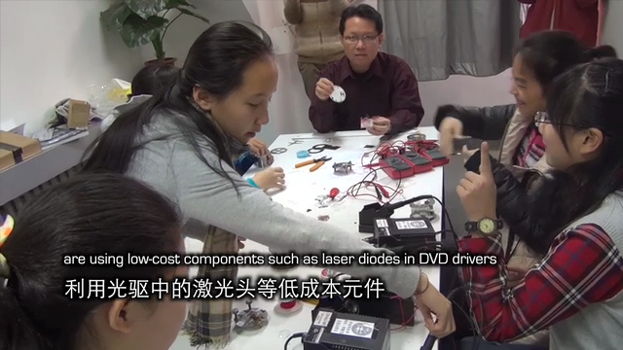
超低价原子力显微镜 (Jan. 2014)

Slide 24
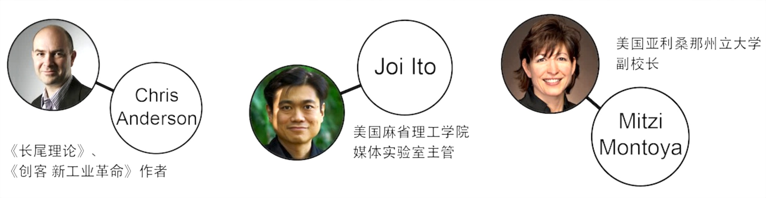
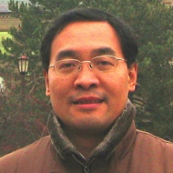





中美绿色电子创意线上大赛
Vice President,
Arizona State Univ.
Director
Media Lab, MIT
Author of Long Tail
Maker, New Industrial Revolution
Share your Green Electronics ideas
with top hackers from around the world!
Deputy Director
Office of Academic Affairs, Tsinghua Univ.
Hong-Bin
SUN

Slide 25

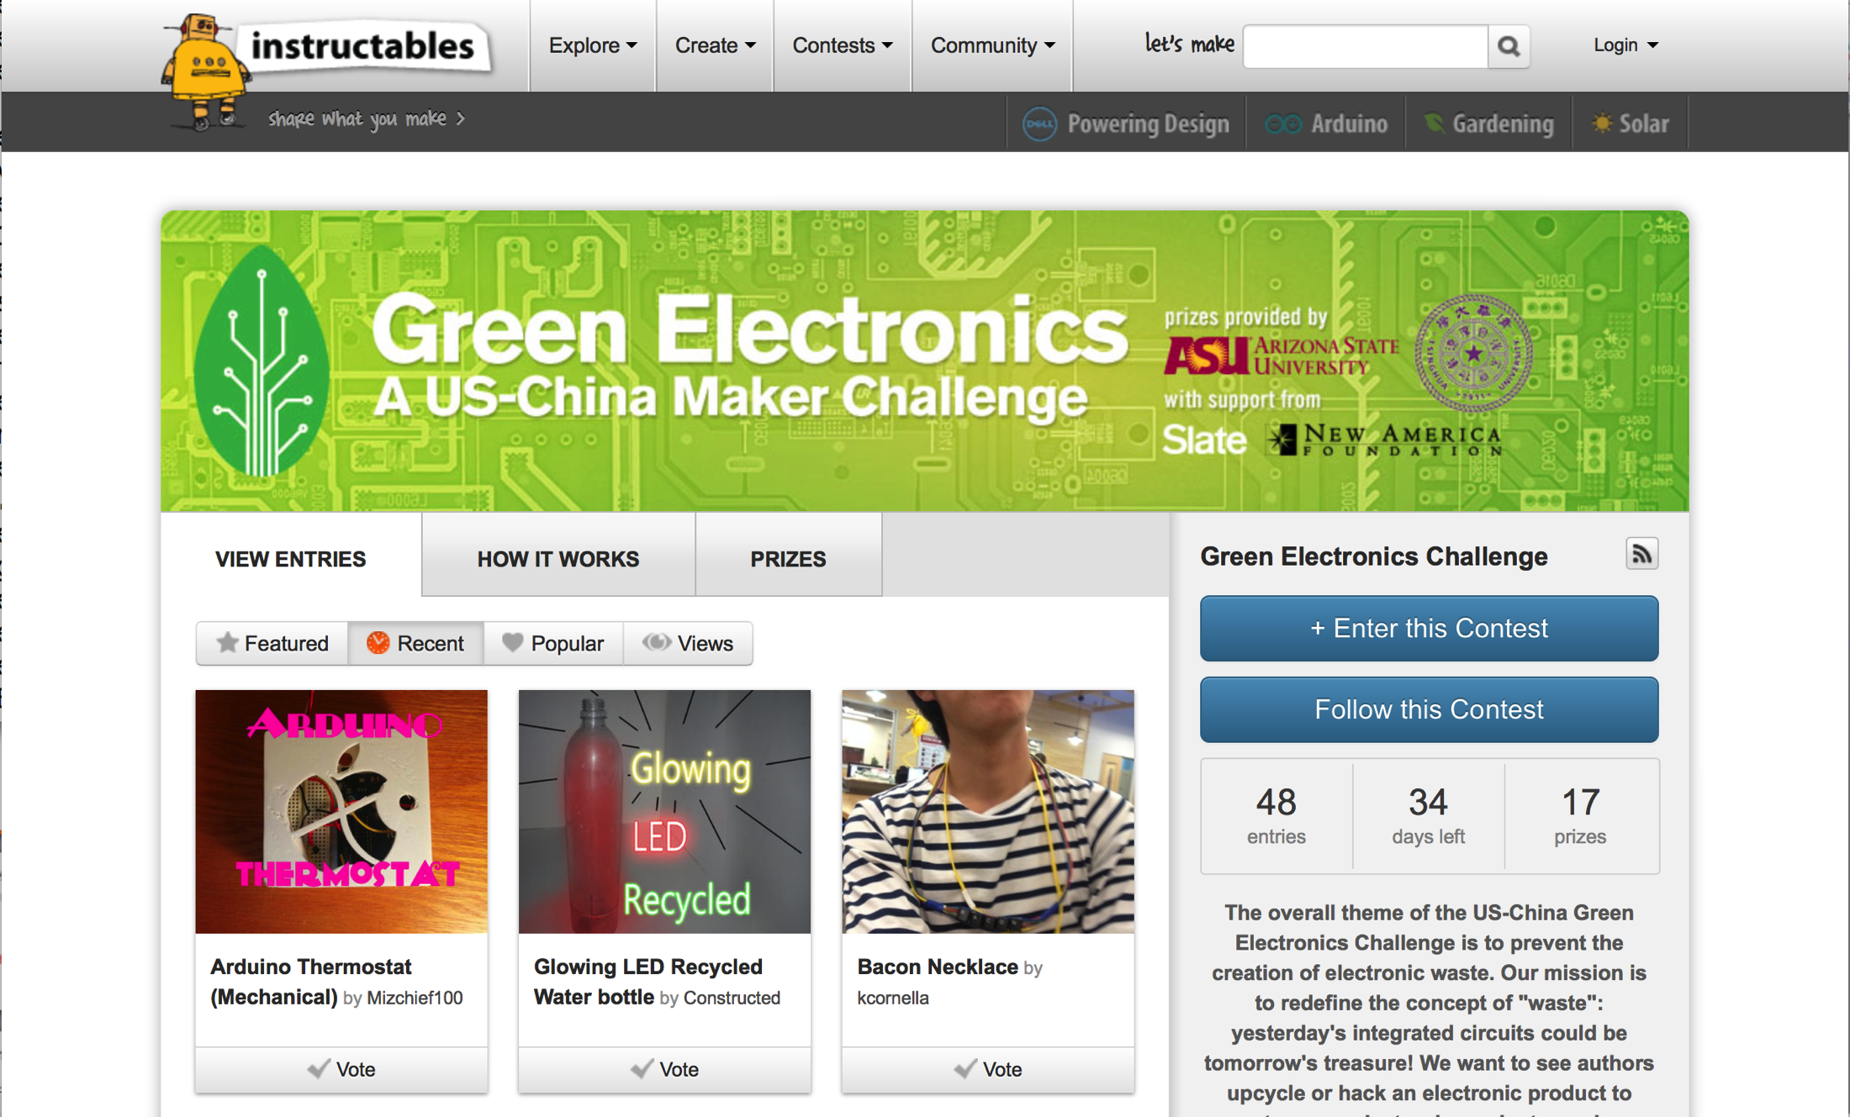
^{国际化双语线上发布媒体}
全球最大的创意作品展示交流平台之一

Slide 26
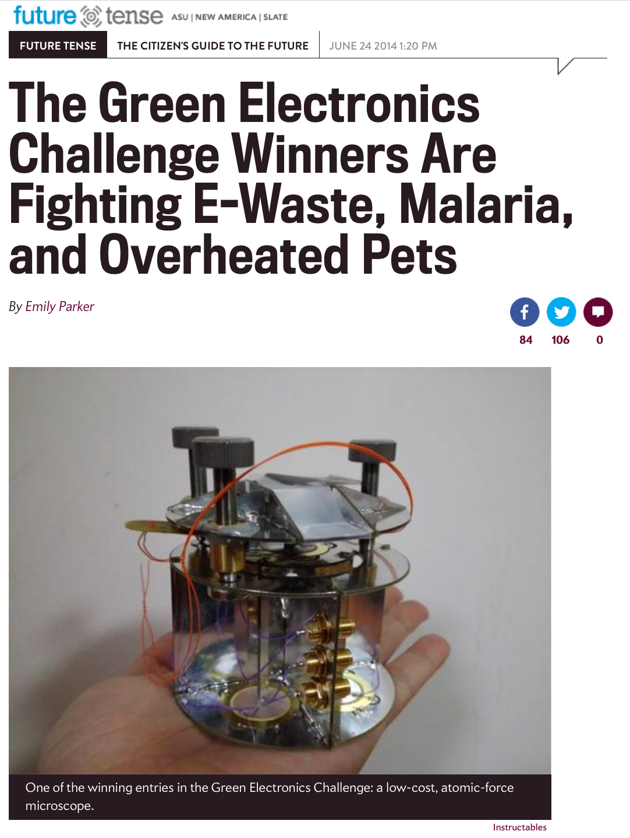

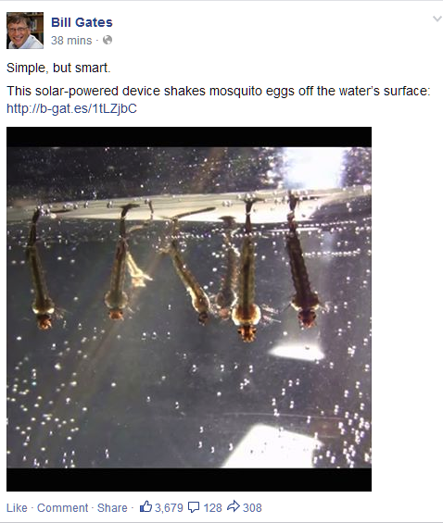
网上媒体反馈

Slide 27
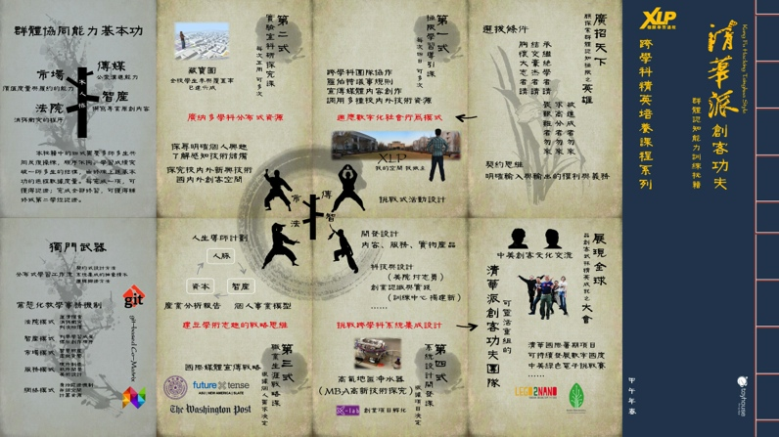
XLP课程系列

Slide 28
探索可复制的规模极限

Slide 29
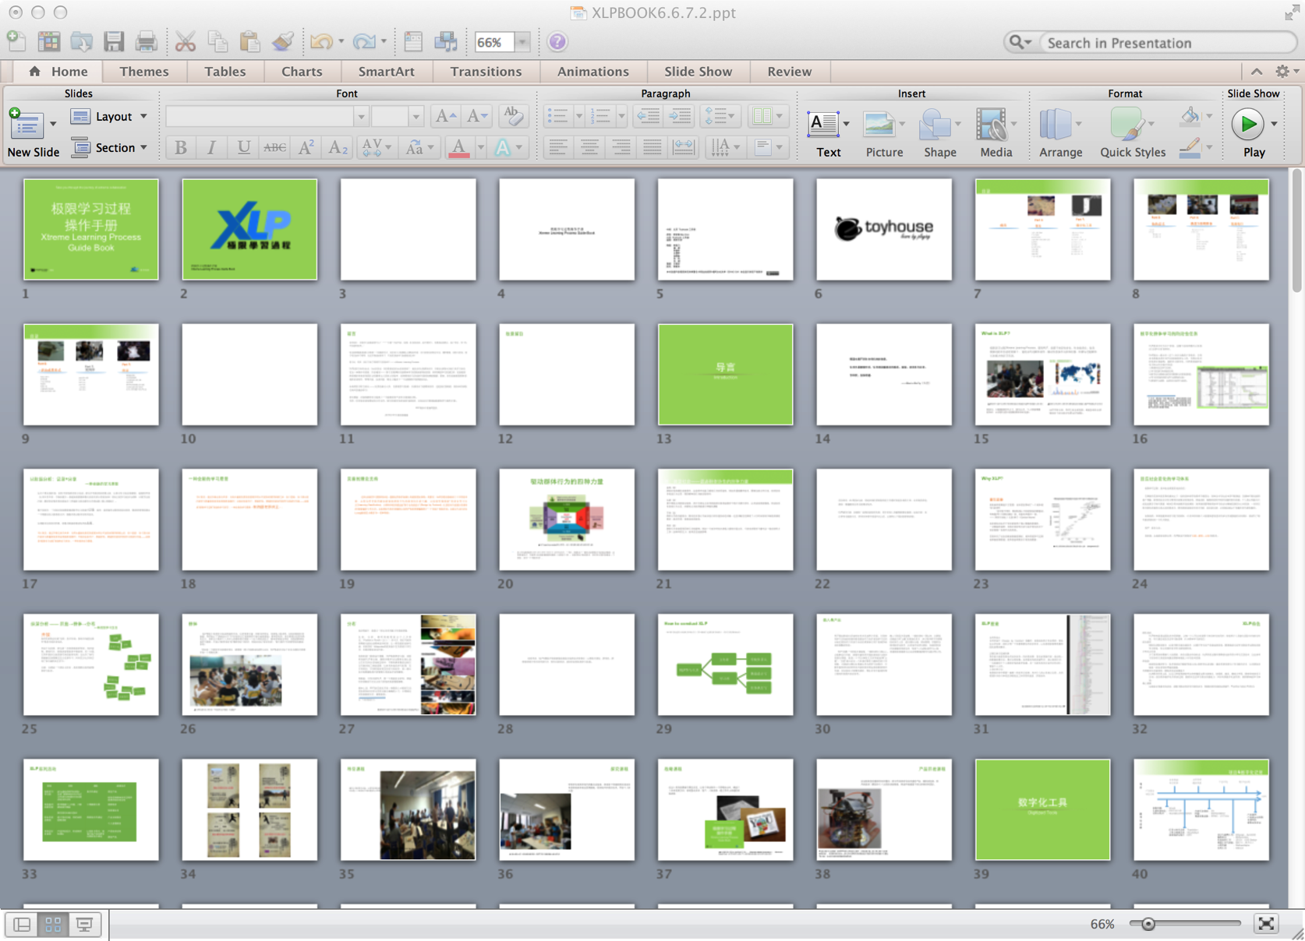
修订XLP操作手册

Slide 30
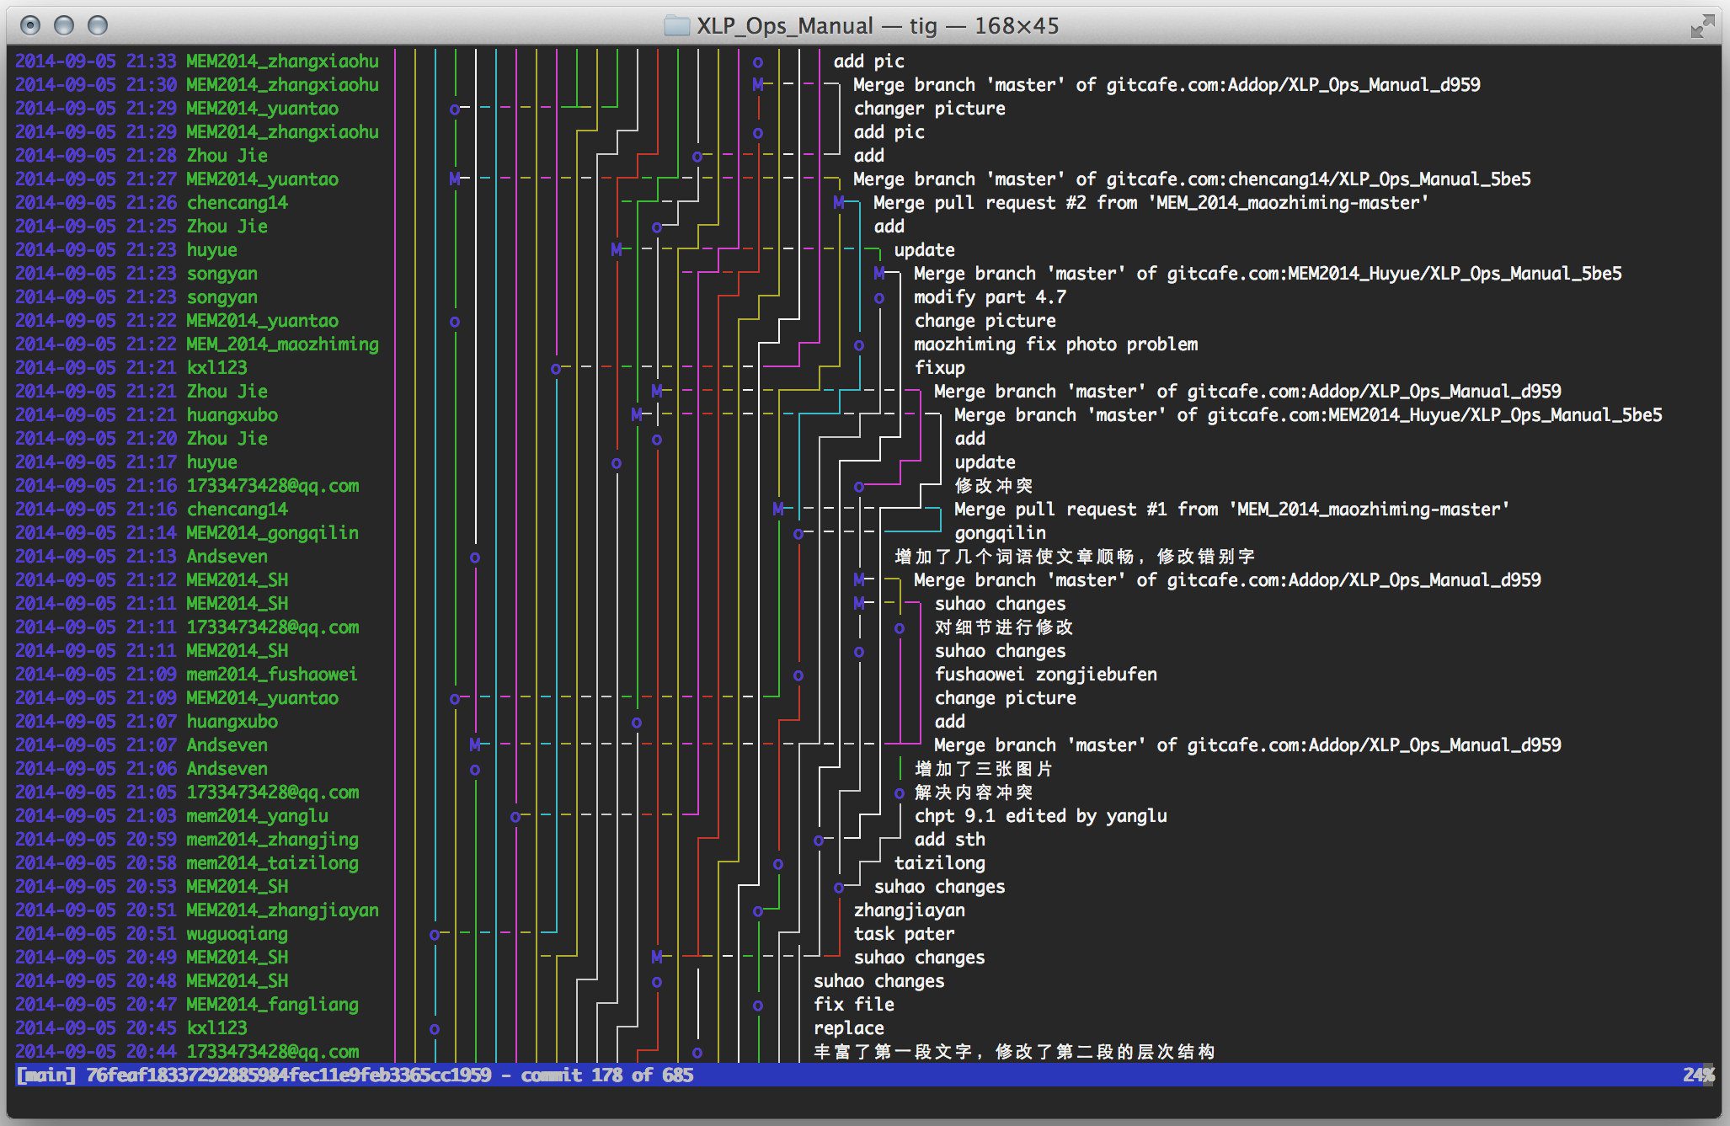
2000+ 修正记录

Slide 31
市场交易记录
Total BTC Units | Total # of Hours Traded | # of Transactions | Max. Transaction Size
1580000 | 52 | 373 | 3680000

Slide 32
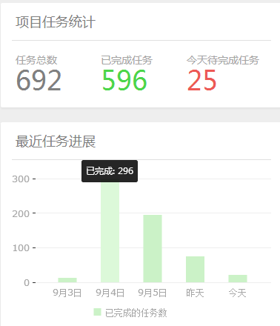
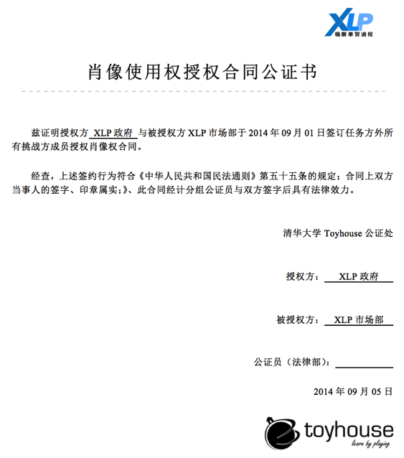
项目管理统计数据
顶层项目管理数据

Slide 33
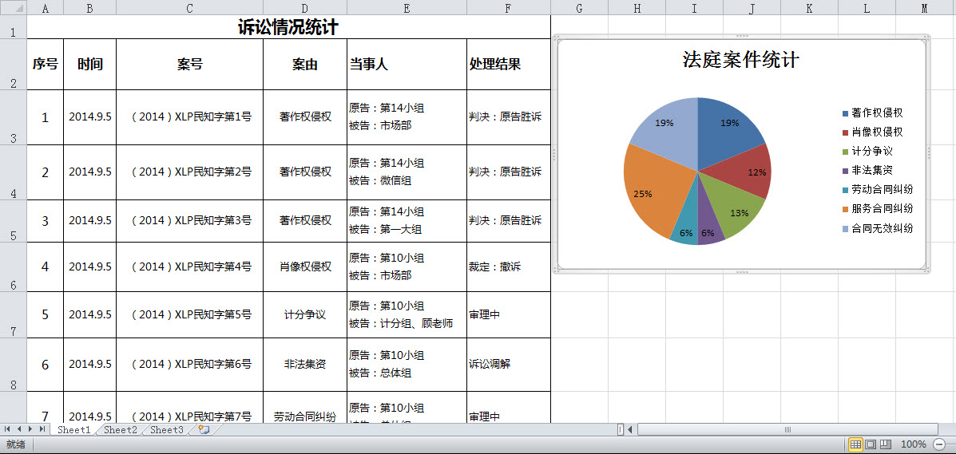
诉讼记录

Slide 34
群体贡献的可视化

Slide 35
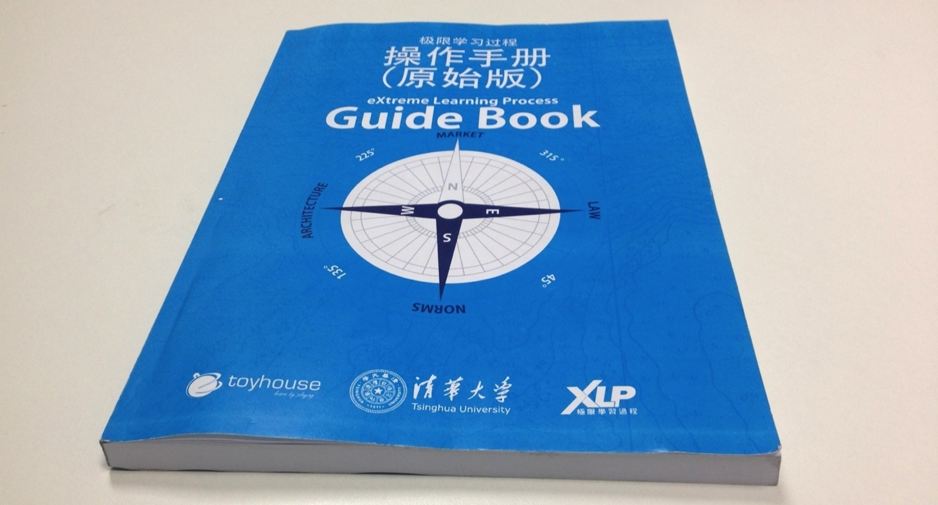
Surprises！
从 177 页到 212 页

Slide 36
学员反馈
课程结束后，…满满的幸福感仍然在我的内心激荡，我相信这是我这一生中最激动、难忘、收获最多的一课，没有之一。
2014MEM学员 鲍哲博

Slide 37
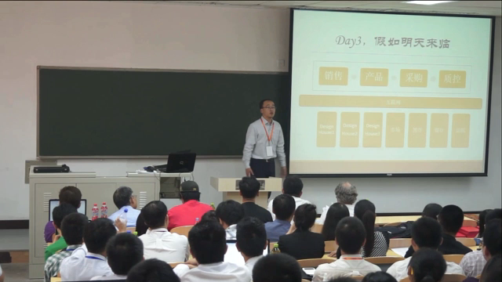
规模效应的认知

Slide 38
Student Feedback on Sep 6, 2014
XLP-enabled Orientation for Incoming Students in Tsinghua’s Engineering Management Masters Degree Program
See video: http://youtu.be/MFrYFst1QHw

Slide 39
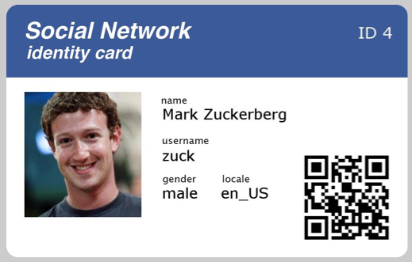




从清华派创客的数字化身份开始重组
清华经管学院顾问委员会
由清华团队提供全球创客的实名制认证

Slide 40







从创客现场活动开始采集实名数字身份
到网络化活动跟进开源贡献过程所用的数字身份
BIOMETRICS,
NATURAL LANGUAGE
PROCESSING
DIGITAL FINGERPRINTS
SPACE HAS AWARENESS
使用git跟踪数字身份指纹并见证开源贡献过程

Slide 41


Slide 42



Slide 43

项目使命
创意重组项目的目标在于利用排列重组的科学方法与技术，把现存的各种资源，经由一个可持续并且可规模化的学习格式，从易于接受的渠道提供给所有人。本项目也将利用一套分布式的活动运行框架来操作跨学科的学习活动，从而可以透过国际合作，丰富现有的教学课程体系。

Slide 44




创意重组项目的四个阶段
数字身份认证科技
创意社区的公约 与 个人参与协议
数字发布平台
组织参与联盟
Notes:
数字身份认证科技
创意社区的公约 与 个人参与协议
数字发布平台
组织参与联盟

Slide 45

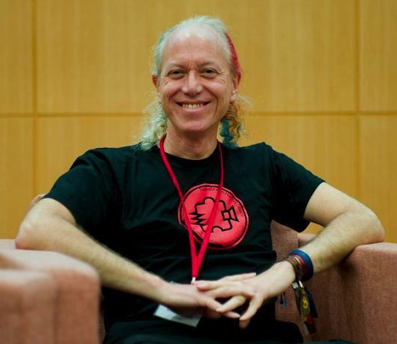
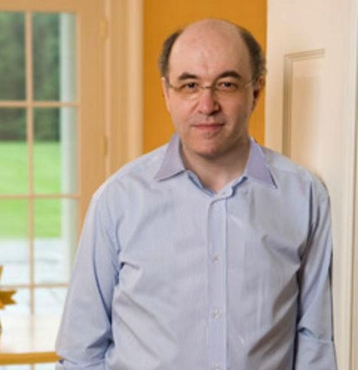
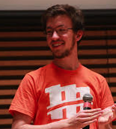

清华驻校创客项目
邀请全球创客参与
Mitch Altman
创客空间全球总召集人
Stephen Wolfram
Mathematica创始人
Adam Williams
MHacks 发起人

Slide 46
Principles of Self-Organizing Learning
Communication,
Reflection,
Collaboration,
Community,
Creative Tools,
Amplification, and
Guided process

Slide 47
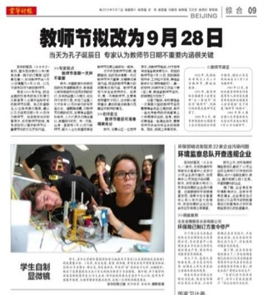
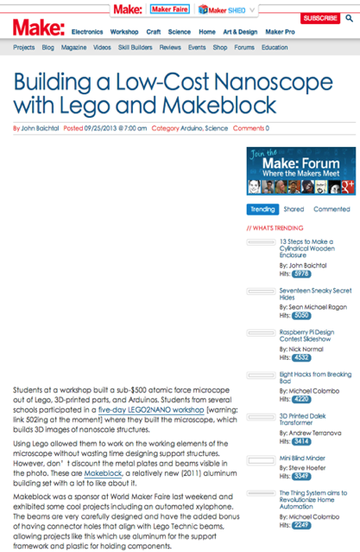
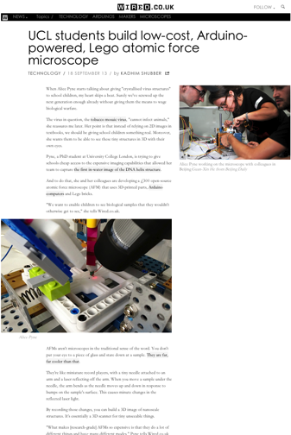
媒体报导

